Slide 1
Concurrency
ITV Real-Time Systems
Anders P. Ravn
Aalborg University
February 2006

Slide 2
Characteristics of a RTS
Timing Constraints
Dependability Requirements
Concurrent control of separate components
Facilities to interact with special purpose hardware

Slide 3
Aim
To illustrate the requirements for concurrent programming
To demonstrate the variety of models for creating processes
To show how processes are created To lay the foundations for studying inter-process communication

Slide 4
Concurrent Programming
Programming notation and techniques for expressing potential parallelism and solving the resulting synchronization and communication problems
Implementation of parallelism is a topic in computer systems (hardware and software) that is independent of concurrent programming
Notes:
Definition comes from Ben Ari
Implementation of parallelism is a topic in computer systems (hardware and software) that is essentially independent of concurrent programming.
The topic has been around for a long time.
|Can we traced back to Conway and Dijkstra in the early 60’s.
Perhaps its defining moment was the publications of
Dijkstra’s paper on Co-operating Sequential Processesin 1965
First concurrent programming language Simula 66?
Not under 1983 until we see the first international standard concurrent programming language - Ada. This Department via Ian Pyle and Ian Wand were involved in that development
Indeed is not Universally accepted that programming languages should be concurrent

Slide 5
Why we need it
To model the parallelism in the real world
Virtually all real-time systems are inherently concurrent
— devices operate in parallel in the real world

Slide 6
Why we need it
The alternative is to use sequential programming techniques
The programmer must construct the system so that it involves the cyclic execution of a program sequence to handle the various concurrent activities
This complicates the programmer's already difficult task and involves him/her in considerations of structures which are irrelevant to the control of the activities in hand
The resulting programs will be more obscure and inelegant
It makes decomposition of the problem more complex
Parallel execution of the program on more than one processor will be much more difficult to achieve
The placement of code to deal with faults is more problematic
Notes:
It is up to the programmer to construct his/her system so that it involves the cyclic execution of a program sequence to handle the various concurrent tasks.
This complicates the programmer's already difficult task and involves him/her in considerations of structures which are irrelevant to the control of the tasks in hand;
The resulting programs will be more obscure and inelegant;
It makes proving program correctness more difficult;
It makes decomposition of the problem more complex;
Parallel execution of the program on more than one processor will be much more difficult to achieve;
The placement of code to deal with faults is more problematic.

Slide 7
Terminology
A concurrent program is a collection of autonomous sequential processes, executing (logically) in parallel
Each process has a single thread of control
The actual implementation (i.e. execution) of a collection of processes usually takes one of three forms.
Multiprogramming
  processes multiplex their executions on a single processor
Multiprocessing
  processes multiplex their executions on a multiprocessor system where there is access to shared memory
Distributed Processing
  processes multiplex their executions on several processors which do not share memory

Slide 8
Process States
Non-existing
Non-existing
Created
Initializing
Terminated
Executable

Slide 9
Processes and Threads
All operating systems provide processes
Processes execute in their own virtual machine (VM) to avoid interference from other processes
Recent OSs provide mechanisms for creating threads within the same virtual machine.
Threads have unrestricted access to their VM. The programmer and the language must provide the protection from interference
Long debate over whether language should define concurrency or leave it up to the O.S.
  Ada and Java provide concurrency
  C, C++ do not

Slide 10
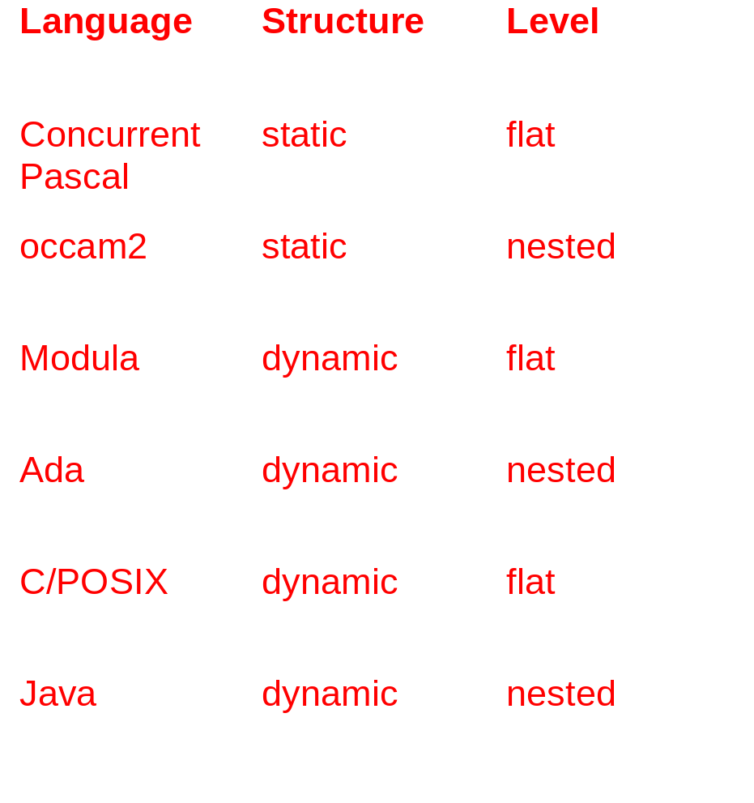
Concurrent Execution
Processes differ in
Structure — static, dynamic
Level — nested, flat

Slide 11
Concurrent Execution
Granularity
- coarse (Ada, POSIX processes/threads, Java)
- fine (occam2)
Initialization — parameter passing, IPC
Termination
  completion of execution of the process body;
  suicide, by execution of a self-terminate statement;
  abortion, through the explicit action of another process;
  occurrence of an untrapped error condition;
  never: processes are assumed to be non-terminating loops;
  when no longer needed.

Slide 12
Process States
Non-existing
Non-existing
Created
Initializing
Terminated
Waiting Child
Initialization
Executable
Waiting Dependent
Termination

Slide 13
Processes and Objects
Active objects — undertake spontaneous actions
Reactive objects — only perform actions when invoked
Resources — reactive but can control order of actions
Passive — reactive, but no control over order
Protected resource — passive resource controller
Server — active resource controller

Slide 14
Process Representation
Coroutines
Fork and Join
Cobegin
Explicit Process Declaration

Slide 15
Coroutine Flow Control
Coroutine A
Coroutine B
Coroutine C
1
2
4
6
5
3
6
resume A
resume B
resume C
13
8
12
7
9
resume A
14
resume B
resume B
10
15
11
12
resume c

Slide 16
Fork and Join
The fork specifies that a designated routine should start executing concurrently with the invoker
Join allows the invoker to wait for the completion of the invoked routine
    function F return is ...;
    procedure P;
    ...
    C:= fork F;
    ...
    J:= join C;
    ...
    end P;
After the fork, P and F will be executing concurrently. At the point of the join, P will wait until the F has finished (if it has not already done so)
Fork and join notation can be found in Mesa and UNIX/POSIX

Slide 17
UNIX Fork Example
for (I=0; I!=10; I++) {
pid[I] = fork();
}
wait . . .
How many processes created?

Slide 18
Explicit Process Declaration
The structure of a program can be made clearer if routines state whether they will be executed concurrently
Note that this does not say when they will execute
  task body Process is
  begin
  . . .
  end;
Languages that support explicit process declaration may have explicit or implicit process/task creation

Slide 19
Activation, Execution & Finalisation
The execution of a task object has three main phases:
Activation ⎯ the elaboration of the declarative part, if any, of the task body (any local variables of the task are created and initialised during this phase)
Normal Execution ⎯ the execution of the statements within the body of the task
Finalisation ⎯ the execution of any finalisation code associated with any objects in its declarative part

Slide 20
Exceptions and Task Activation
If an exception is raised in the elaboration of a declarative part, any tasks created during that elaboration are never activated but become terminated
If an exception is raised during a task's activation, the task becomes completed or terminated and the predefined exception Tasking_Error is raised prior to the first executable statement of the declarative block (or after the call to the allocator); this exception is raised just once
The raise will wait until all currently activating tasks finish their activation

Slide 21
Completion versus Termination
A task completes when
  finishes execution of its body (either normally or as the result of an unhandled exception).
  it executes a "terminate" alternative of a select statement (see later) thereby implying that it is no longer required.
  it is aborted.
A task terminates when all is dependents have terminated.
An unhandled exception in a task is isolated to just that task. Another task can enquire (by the use of an attribute) if a task has terminated:
  if T’Terminated then -- for some task T
  -- error recovery action
  end if;
However, the enquiring task cannot differentiate between normal or error termination of the other task.

Slide 22
Task Abortion
Any task can abort any other task whose name is in scope
When a task is aborted all its dependents are also aborted — why?
The abort facility allows wayward tasks to be removed
If, however,a rogue task is anonymous then it cannot be named and hence cannot easily be aborted. How could you abort it?
It is desirable, therefore, that only terminated tasks are made anonymous

Slide 23
Concurrency in Java
Java has a predefined class java.lang.Thread which provides the mechanism by which threads (processes) are created.
However to avoid all threads having to be child classes of Thread, it also uses a standard interface
  public interface Runnable {
  public abstract void run();
  }
Hence, any class which wishes to express concurrent execution must implement this interface and provide the run method

Slide 24
public class Thread extends Object implements Runnable
{
public Thread();
public Thread(Runnable target);
public void run();
public native synchronized void start();
// throws IllegalThreadStateException
public static Thread currentThread();
public final void join() throws InterruptedException;
public final native boolean isAlive();
public void destroy();
// throws SecurityException;
public final void stop();
// throws SecurityException --- DEPRECIATED
public final void setDaemon();
// throws SecurityException, IllegalThreadStateException
public final boolean isDaemon();
// Note, RuntimeExceptions are not listed as part of the
// method specification. Here, they are shown as comments
}

Slide 25
Robot Arm Example
public class UserInterface
{
public int newSetting (int Dim) { ... }
...
}
public class Arm
{
public void move(int dim, int pos) { ... }
}
UserInterface UI = new UserInterface();
Arm Robot = new Arm();

Slide 26
Robot Arm Example
public class Control extends Thread
{
private int dim;
public Control(int Dimension) // constructor
{
super();
dim = Dimension;
}
public void run()
{
int position = 0;
int setting;
while(true)
{
Robot.move(dim, position);
setting = UI.newSetting(dim);
position = position + setting;
}
}
}

Slide 27
Robot Arm Example
final int xPlane = 0; // final indicates a constant
final int yPlane = 1;
final int zPlane = 2;
Control C1 = new Control(xPlane);
Control C2 = new Control(yPlane);
Control C3 = new Control(zPlane);
C1.start();
C2.start();
C3.start();

Slide 28
Alternative Robot Control
public class Control implements Runnable
{
private int dim;
public Control(int Dimension) // constructor
{
dim = Dimension;
}
public void run()
{
int position = 0;
int setting;
while(true)
{
Robot.move(dim, position);
setting = UI.newSetting(dim);
position = position + setting;
}
}
}

Slide 29
Alternative Robot Control
final int xPlane = 0;
final int yPlane = 1;
final int zPlane = 2;
Control C1 = new Control(xPlane); // no thread created yet
Control C2 = new Control(yPlane);
Control C3 = new Control(zPlane);
// constructors passed a Runnable interface and threads created
Thread X = new Thread(C1);
Thread Y = new Thread(C2);
Thread Z = new Thread(C2);
X.start(); // thread started
Y.start();
Z.start();

Slide 30
Java Thread States
non-existing
Create thread object
new
start
executable
run method exits
stop, destroy
blocked
dead

Slide 31
Points about Java Threads
Java allows dynamic thread creation
Java (by means of constructor methods) allows arbitrary data to be passed as parameters
Java allows thread hierarchies and thread groups to be created but there is no master or guardian concept; Java relies on garbage collection to clean up objects which can no longer be accessed
The main program in Java terminates when all its user threads have terminated (see later)
One thread can wait for another thread (the target) to terminate by issuing the join method call on the target's thread object.
The isAlive method allows a thread to determine if the target thread has terminated

Slide 32
A Thread Terminates:
when it completes execution of its run method either normally or as the result of an unhandled exception;
via its stop method — the run method is stopped and the thread class cleans up before terminating the thread (releases locks and executes any finally clauses)
  the thread object is now eligible for garbage collection.
  if a Throwable object is passed as a parameter to stop, then this exception is thrown in the target thread; this allows the run method to exit more gracefully and cleanup after itself
  stop is inherently unsafe as it releases locks on objects and can leave those objects in inconsistent states; the method is now deemed obsolete (depreciated) and should not be used
by its destroy method being called — destroy terminates the thread without any cleanup (never been implemented in the JVM)

Slide 33
Daemon Threads
Java threads can be of two types: user threads or daemon threads
Daemon threads are those threads which provide general services and typically never terminate
When all user threads have terminated, daemon threads can also be terminated and the main program terminates
The setDaemon method must be called before the thread is started
(Daemon threads provide the same functionality as the Ada “or terminate” option on the select statement)

Slide 34
Thread Exceptions
The IllegalThreadStateException is thrown when:
  the start method is called and the thread has already been started
  the setDaemon method has been called and the thread has already been started
The SecurityException is thrown by the security manager when:
  a stop or destroy method has been called on a thread for which the caller does not have the correct permissions for the operation requested
The NullPointerException is thrown when:
  A null pointer is passed to the stop method
The InterruptException is thrown if a thread which has issued a join method is woken up by the thread being interrupted rather than the target thread terminating

Slide 35
Concurrent Execution in POSIX
Provides two mechanisms: fork and pthreads.
fork creates a new process
pthreads are an extension to POSIX to allow threads to be created
All threads have attributes (e.g. stack size)
To manipulate these you use attribute objects
Threads are created using an appropriate attribute object

Slide 36
Typical C POSIX interface
typedef ... pthread_t; /* details not defined */
typedef ... pthread_attr_t;
int pthread_attr_init(pthread_attr_t *attr);
int pthread_attr_destroy(pthread_attr_t *attr);
int pthread_attr_setstacksize(..);
int pthread_attr_getstacksize(..);
int pthread_create(pthread_t *thread, const pthread_attr_t *attr,
void *(*start_routine)(void *), void *arg);
/* create thread and call the start_routine with the argument */
int pthread_join(pthread_t thread, void **value_ptr);
int pthread_exit(void *value_ptr);
/* terminate the calling thread and make the pointer value_ptr
available to any joining thread */
All functions returns 0 if successful,
otherwise an error number
pthread_t pthread_self(void);

Slide 37
Shared Variable-Based Synchronization and Communication
To understand the requirements for communication and synchronisation based on shared variables
To briefly review semaphores, monitors and conditional critical regions

Slide 38
Shared Variable Communication
Examples: busy waiting, semaphores and monitors
Unrestricted use of shared variables is unreliable and unsafe due to multiple update problems
Consider two processes updating a shared variable, X, with the assignment: X:= X+1
  load the value of X into some register
  increment the value in the register by 1 and
  store the value in the register back to X
As the three operations are not indivisible, two processes simultaneously updating the variable could follow an interleaving that would produce an incorrect result

Slide 39
Mutual Exclusion
A sequence of statements that must appear to be executed indivisibly is called a critical section
The synchronisation required to protect a critical section is known as mutual exclusion
Atomicity is assumed to be present at the memory level. If one process is executing X:= 5, simultaneously with another executing X:= 6, the result will be either 5 or 6 (not some other value)
If two processes are updating a structured object, this atomicity will only apply at the single word element level

Slide 40
Condition Synchronisation
Condition synchronisation is needed when a process wishes to perform an operation that can only sensibly, or safely, be performed if another process has itself taken some action or is in some defined state
E.g. a bounded buffer has 2 condition synchronisation:
  the producer processes must not attempt to deposit data onto the buffer if the buffer is full
  the consumer processes cannot be allowed to extract objects from the buffer if the buffer is empty
Is mutual exclusion necessary?
head
tail

Slide 41
Busy Waiting
One way to implement synchronisation is to have processes set and check shared variables that are acting as flags
This approach works well for condition synchronisation but no simple method for mutual exclusion exists
Busy wait algorithms are in general inefficient; they involve processes using up processing cycles when they cannot perform useful work
Even on a multiprocessor system they can give rise to excessive traffic on the memory bus or network (if distributed)

Slide 42
Semaphores
A semaphore is a non-negative integer variable that apart from initialization can only be acted upon by two procedures P (or WAIT) and V (or SIGNAL)
WAIT(S) If the value of S > 0 then decrement its value by one; otherwise delay the process until S > 0 (and then decrement its value).
SIGNAL(S) Increment the value of S by one.
WAIT and SIGNAL are atomic (indivisible). Two processes both executing WAIT operations on the same semaphore cannot interfere with each other and cannot fail during the execution of a semaphore operation

Slide 43
Process States
Non-existing
Non-existing
Created
Initializing
Terminated
Waiting Child
Initialization
Executable
Waiting Dependent
Termination
Suspended

Slide 44
Deadlock
Two processes are deadlocked if each is holding a resource while waiting for a resource held by the other
  type Sem is ...;
  X : Sem := 1; Y : Sem := 1;
  task A;
  task body A is
  begin
  ...
  Wait(X);
  Wait(Y);
  ...
  end A;
  task B;
  task body B is
  begin
  ...
  Wait(Y);
  Wait(X);
  ...
  end B;

Slide 45
Livelock
Two processes are livelocked if each is executing but neither is able to make progress.
type Flag is (Up, Down);
Flag1 : Flag := Up;
task A;
task body A is
begin
...
while Flag1 = Up loop
null;
end loop;
...
end A;
task B;
task body B is
begin
...
while Flag1 = Up loop
null;
end loop;
...
end A;

Slide 46
Criticisms of semaphores
Semaphore are an elegant low-level synchronisation primitive, however, their use is error-prone
If a semaphore is omitted or misplaced, the entire program collapses. Mutual exclusion may not be assured and deadlock may appear just when the software is dealing with a rare but critical event
A more structured synchronisation primitive is required
No high-level concurrent programming language relies entirely on semaphores; they are important historically but are arguably not adequate for the real-time domain

Slide 47
Synchronized Methods
Java provides a mechanism by which monitors can be implemented in the context of classes and objects
There is a lock associated with each object which cannot be accessed directly by the application but is affected by
  the method modifier synchronized
  block synchronization.
When a method is labeled with the synchronized modifier, access to the method can only proceed once the lock associated with the object has been obtained
Hence synchronized methods have mutually exclusive access to the data encapsulated by the object, if that data is only accessed by other synchronized methods
Non-synchronized methods do not require the lock and, therefore, can be called at any time

Slide 48
Example of Synchronized Methods
public class SharedInteger
{
private int theData;
public SharedInteger(int initialValue)
{
theData = initialValue;
}
public int read()
{
return theData;
};
public synchronized void write(int newValue)
{
theData = newValue;
};
public synchronized void incrementBy(int by)
{
theData = theData + by;
};
}
SharedInteger myData = new SharedInteger(42);

Slide 49
Block Synchronization
Provides a mechanism whereby a block can be labeled as synchronized
The synchronized keyword takes as a parameter an object whose lock it needs to obtain before it can continue
Hence synchronized methods are effectively implementable as
  public int read()
  {
  synchronized(this) {
  return theData;
  }
  }
Where this is the Java mechanism for obtaining the current object

Slide 50
Warning
Used in its full generality, the synchronized block can undermine one of the advantages of monitor-like mechanisms, that of encapsulating synchronization constraints associate with an object into a single place in the program
This is because it is not possible to understand the synchronization associated with a particular object by just looking at the object itself when other objects can name that object in a synchronized statement.
However with careful use, this facility augments the basic model and allows more expressive synchronization constraints to be programmed

Slide 51
Static Data
Static data is shared between all objects created from the class
To obtain mutually exclusive access to this data requires all objects to be locked
In Java, classes themselves are also objects and therefore there is a lock associated with the class
This lock may be accessed by either labeling a static method with the synchronized modifier or by identifying the class's object in a synchronized block statement
The latter can be obtained from the Object class associated with the object
Note, however, that this class-wide lock is not obtained when synchronizing on the object

Slide 52
Static Data
class StaticSharedVariable
{
private static int shared;
...
public int Read()
{
synchronized(this.getClass())
{
return shared;
};
}
public static synchronized void Write(int I)
{
shared = I;
};
}

Slide 53
Waiting and Notifying
To obtain conditional synchronization requires the methods provided in the predefined object class
  public void wait() throws InterruptedException;
  // also throws IllegalMonitorStateException
  public void notify();
  // throws IllegalMonitorStateException
  public void notifyAll();
  // throws IllegalMonitorStateException
These methods should be used only from within methods which hold the object lock
If called without the lock, the exception IllegalMonitor-StateException is thrown

Slide 54
Waiting and Notifying
The wait method always blocks the calling thread and releases the lock associated with the object
A wait within a nested monitor releases only the inner lock
The notify method wakes up one waiting thread; the one woken is not defined by the Java language
Notify does not release the lock; hence the woken thread must wait until it can obtain the lock before proceeding
To wake up all waiting threads requires use of the notifyAll method
If no thread is waiting, then notify and notifyAll have no effect

Slide 55
Thread Interruption
A waiting thread can also be awoken if it is interrupted by another thread
In this case the InterruptedException is thrown

Slide 56
Condition Variables
There are no explicit condition variables. An awoken thread should usually evaluate the condition on which it is waiting (if more than one exists and they are not mutually exclusive)
public class BoundedBuffer {
private int buffer[];
private int first;
private int last;
private int numberInBuffer = 0;
private int size;
public BoundedBuffer(int length) {
size = length;
buffer = new int[size];
last = 0;
first = 0;
};

Slide 57
public synchronized void put(int item)
throws InterruptedException
{
while (numberInBuffer == size) {
wait();
};
last = (last + 1) % size ; // % is modulus
numberInBuffer++;
buffer[last] = item;
notify();
};
public synchronized int get() throws InterruptedException
{
while (numberInBuffer == 0) {
wait();
};
first = (first + 1) % size ; // % is modulus
numberInBuffer--;
notify();
return buffer[first];
};
}

Slide 58
Summary
critical section — code that must be executed under mutual exclusion
producer-consumer system — two or more processes exchanging data via a finite buffer
busy waiting — a process continually checking a condition to see if it is now able to proceed
livelock — an error condition in which one or more processes are prohibited from progressing whilst using up processing cycles
deadlock — a collection of suspended processes that cannot proceed
indefinite postponement — a process being unable to proceed as resources are not made available

Slide 59
Summary
semaphore — a non-negative integer that can only be acted upon by WAIT and SIGNAL atomic procedures
Two more structured primitives are: condition critical regions and monitors
Suspension in a monitor is achieved using condition variable
POSIX mutexes and condition variables give monitors with a procedural interface
Ada’s protected objects give structured mutual exclusion and high-level synchronization via barriers
Java’s synchronized methods provide monitors within an object-oriented framework

